Slide 1
Planning Quantum Stack les 4
Minor Quantum Computing
Ed Kuijpers, e.a.kuijpers@hva.nl
17-5-2024

Slide 2
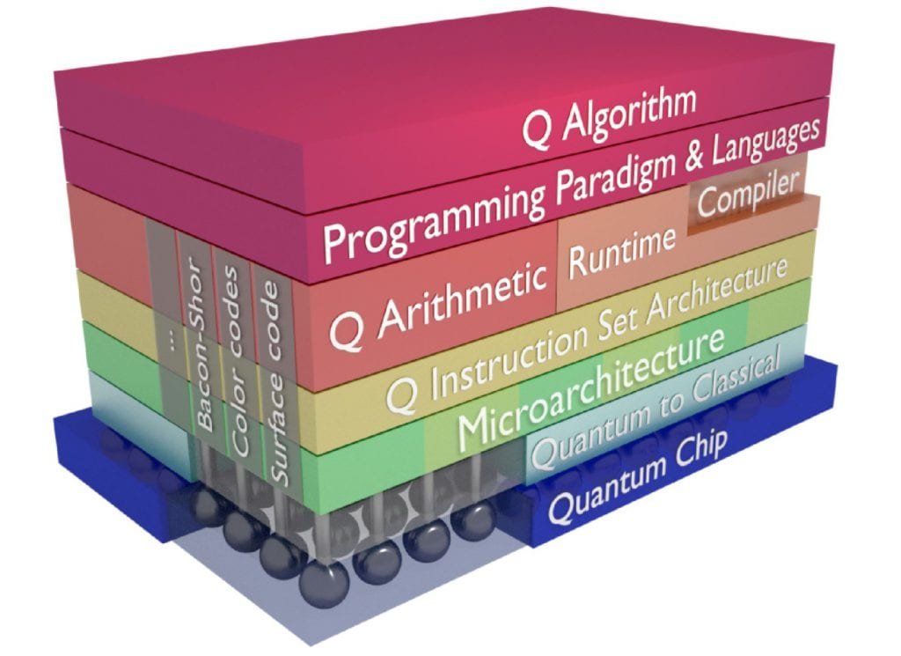
Topics
Structure lessons
Writing paper and presentation in phases
Structure quantum stack
Discussion topics for paper

Slide 3
Quantum Stack
Abstraction layers
Stack models

Slide 4
Structure lessons
Each lesson presentation wil focus on a layer in Quantum Stack
Students individually select Quantum stack topic for writing paper
Students select, motivate and present a topic
Students present draft paper/progress
Finalize paper with final presentation

Slide 5
Draft schedule update
Lesson 1: (19 April): introduction topics
Lesson 2: (26 April)Quantum computing Languages + student paper proposals
Lesson 3: (17 May) Hardware and background + student paper proposals
Lesson 4: (24 May) Quantum hardware, sensing, theory + proposals
Lesson 5 (31 May): Quantum internet + progress reporting paper students
Lesson 6 (7 June):Quantum Information and learning + progress reporting paper
Lesson 7 (14 June): Quantum stack background + progress reporting+
Lesson 8 (18 June): Paper presentation
Week B5 (Aug): Resit Presentation

Slide 6
Approach
Assignment-1 proposed content paper
Title
Research questions
Motivation
Literature reference(s)
Assignment-2 intermediate results
Draft paper material
Presentation intermediate results
Intermediate feedback via paper and presentations
Assignment-3 upload final paper
Final presentation
Grading

Slide 7
Background
Previous experience for the Software for Science minor (before Quantum Computing)
Number of pages (in English): effort in accordance with Credits (3 ECTS) and quality (7 – 12 pages) including some good figures
https://studiegids.hva.nl/co/hbo-ict-vt/100000042/100888)
In assessment: mix of software experiments with documentation appreciated
Scientific format paper (LaTeX), backup pdf after MSWord conversion
Diversity in topics to avoid too much overlap, interesting,
Avoid grading work twice, i.e. team project result assessment and paper assessment not overlapping
Topics lessons will be adapted to research questions as far as possible (lesson will not limited to one layer)
New Qubit material (Graphene, gold based, superconduction at higher temperatures)

Slide 8
Paper proposals presented en in DLO
Optical computing (Daniel)
Advanced Quantum error correction (recent developments at Microsoft and IBM)(luca)
OpenQL (Gaurav)
Theoretical design of a QPU(Lilith)
ML en quantum stack for real life cases(Thomas)
OpenQasm(Tijs)
Qubit interaction and physics/electronics? (Ilnur)(ok)
Sensing(Benjamin)
The Hybrid Computer: A Classical and Quantum Stack Combined(Qing)

Slide 9
To be presented
Quantum Processor network for variational quantum eigensolver(Siar)(presentation open)
Quantum training acceleration for AI Processes (Jaden) (to be presented and uploaded)
Quantum and healthcare (Amira)
Transpiling (Bas)
Quantun Random Number Generation (QRNG) (Quincy)(presentation online open)
Comparison of Qubits (Sebastiaan)
Comparison of quantum technlo(Remy)
Quantum memory ?

Slide 10
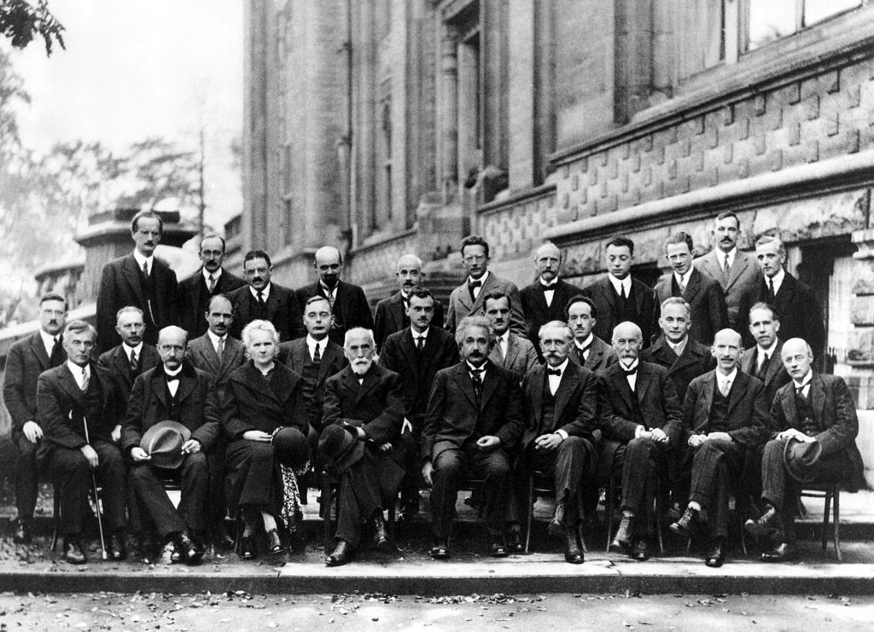
Quantum Mechanics
Solvay conference 1927

Slide 11
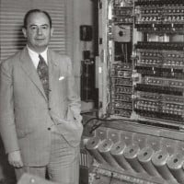
Quantum and Classical Computing
John Von Neumann made major contributions to many fields, including mathematics (foundations of mathematics, functional analysis, ergodic theory, group theory, representation theory, operator algebras, geometry, topology, and numerical analysis), physics (quantum mechanics, hydrodynamics, and quantum statistical mechanics), economics (game theory), computing (Von Neumann architecture, linear programming, self-replicating machines, stochastic computing), and statistics. He was a pioneer of the application of operator theory to quantum mechanics in the development of functional analysis, and a key figure in the development of game theory and the concepts of cellular automata, the universal constructor and the digital computer.
John von Neuman

Slide 12
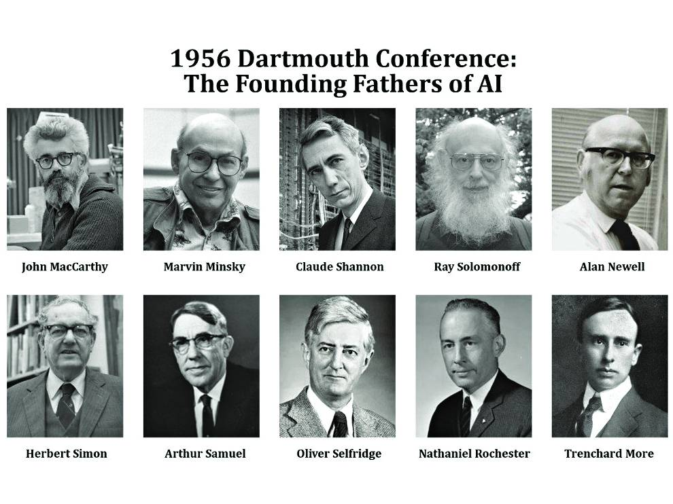
Founding Fathers AI
https://mc.ai/whos-that-kid-laughing-with-high-socks-in-the-middle-of-summer/

Slide 13
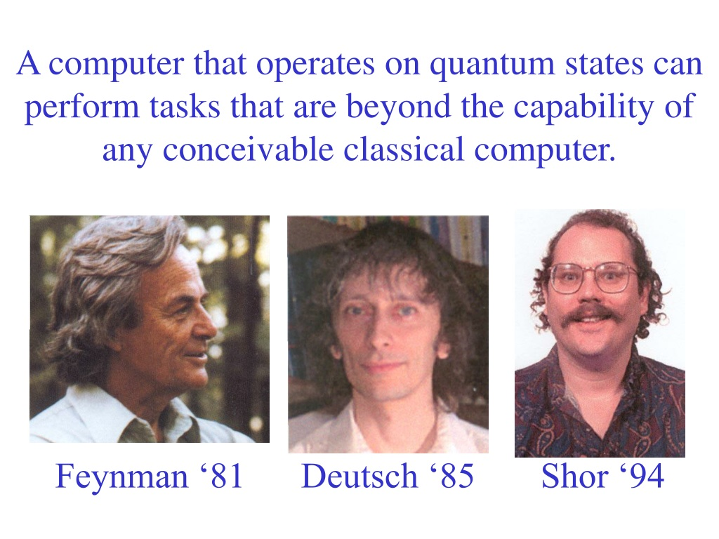
Founding fathers Quantum Computing(1)

Slide 14
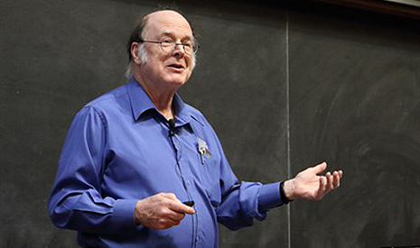
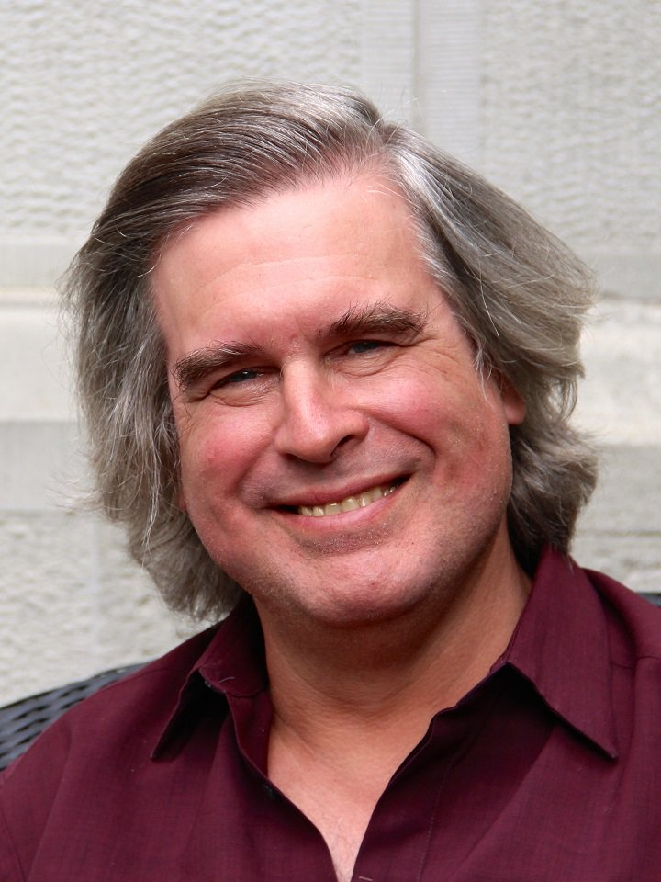
Founding fathers Quantum Computing(2)
Charles Bennett
Gilless Brassard
Charles Bennett discovered, with Gilles Brassard, the concept of quantum cryptography and is one of the founding fathers of modern quantum information theory

Slide 15
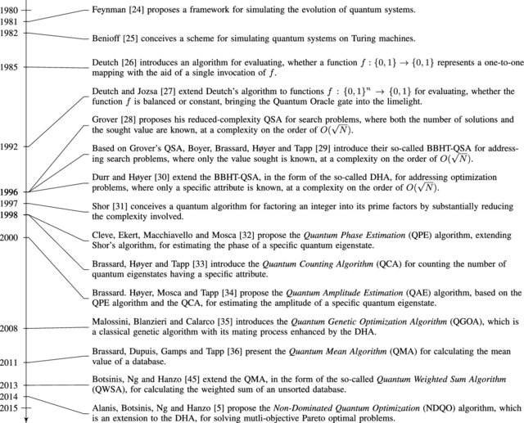
Quantum Computing history

